Slide 1
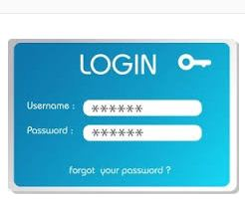

Slide 2

I want Login form with signup attached there and in black color?????

Slide 3
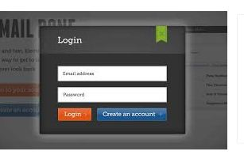

Slide 4
Introduction
According to ANSI/IEEE 1059 standard, Testing can be defined as - A process of analyzing a software item to detect the differences between existing and required conditions (that is defects/errors/bugs) and to evaluate the features of the software item.

Slide 5
In simple words, testing is executing a system in order to identify any gaps, errors, or missing requirements in contrary to the actual requirements.

Slide 6


Slide 7
Objectives
Finding defects which may get created by the programmer.
Gaining confidence in and providing information about the level of quality.
To prevent defects.

Slide 8
To make sure that the end result meets the business and user requirements.
To ensure that it satisfies the BRS that is Business Requirement Specification and SRS that is System Requirement Specifications.
To gain the confidence of the customers by providing them a quality product.

Slide 9
Who does Testing?
It depends on the process and the associated stakeholders of the project(s).
Different companies have different designations for people who test the software

Slide 10
In most cases, the following professionals are involved.
Software Tester
Software Developer
Project Lead/Manager
End User

Slide 11
Testing Methods
Black Box Testing
White Box Testing
Gray Box Testing

Slide 12
Black Box Testing
Testing without having any knowledge of the interior working of the application .
Tester doesn’t have the access of source code
Needn’t not know the internal working of the application.
Main focus in the functionality of the system as a whole
This is known as the behavior testing .
focuses on the functional requirements of the software

Slide 13
Black Box Testing
Black-box testing attempts to find errors in the following categories:
(1) incorrect or missing functions
(2) interface errors
(3) errors in data structures or external database access
(4) behavior or performance errors

Slide 14
Methods of Black Box Testing
Graph Based Testing
Equivalent Partitioning
Boundary Value Analysis
Orthogonal Array Testing

Slide 15
White Box Testing
Internal details and system is made visible
White Box technique is used by both developers as well as testers.
Highly efficient method to find bugs .
Known as Glass Box ,Open Box ,Transparent Box Testing.
Main focus on the structural part of the application.

Slide 16
Methods
Basis Path Testing: Flow Graph, Independent program path
Control Structure Testing : Condition Testing, Data flow testing, Condition Testing, loop testing

Slide 17
Gray Box Testing
Gray-box testing is a combination of white-box testing and black-box testing.
The aim of this testing is to search for the defects.
Gray-box testing is beneficial.

Slide 18
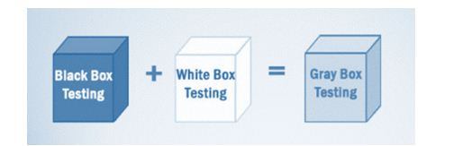

Slide 19
Software Testing Tools
There are numerous tools available in the market .
1.Katalon Studio
2. HP Unified Functional Testing (UFT)
3. IBM Rational Functional Tester

Slide 20
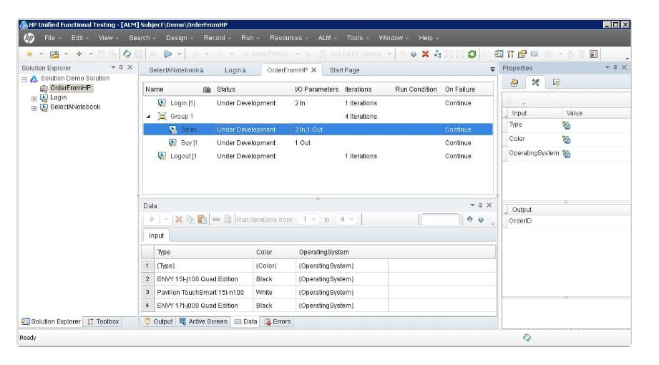
HP Unified Functional Testing (UFT)

Slide 21
Boundary Value Analysis
A greater number of errors occurs at the boundaries of the input domain rather than in the “center.”
It is for this reason that boundary value analysis (BVA) has been developed as a testing technique.
Boundary value analysis leads to a selection of test cases that exercise bounding values.
Boundary value analysis is a testcase design technique that complements equivalence partitioning.
Rather than selecting any element of an equivalence class, BVA leads to the selection of test cases at the “edges” of the class.
Rather than focusing solely on input conditions, BVA derives test cases from the output domain as well

Slide 22
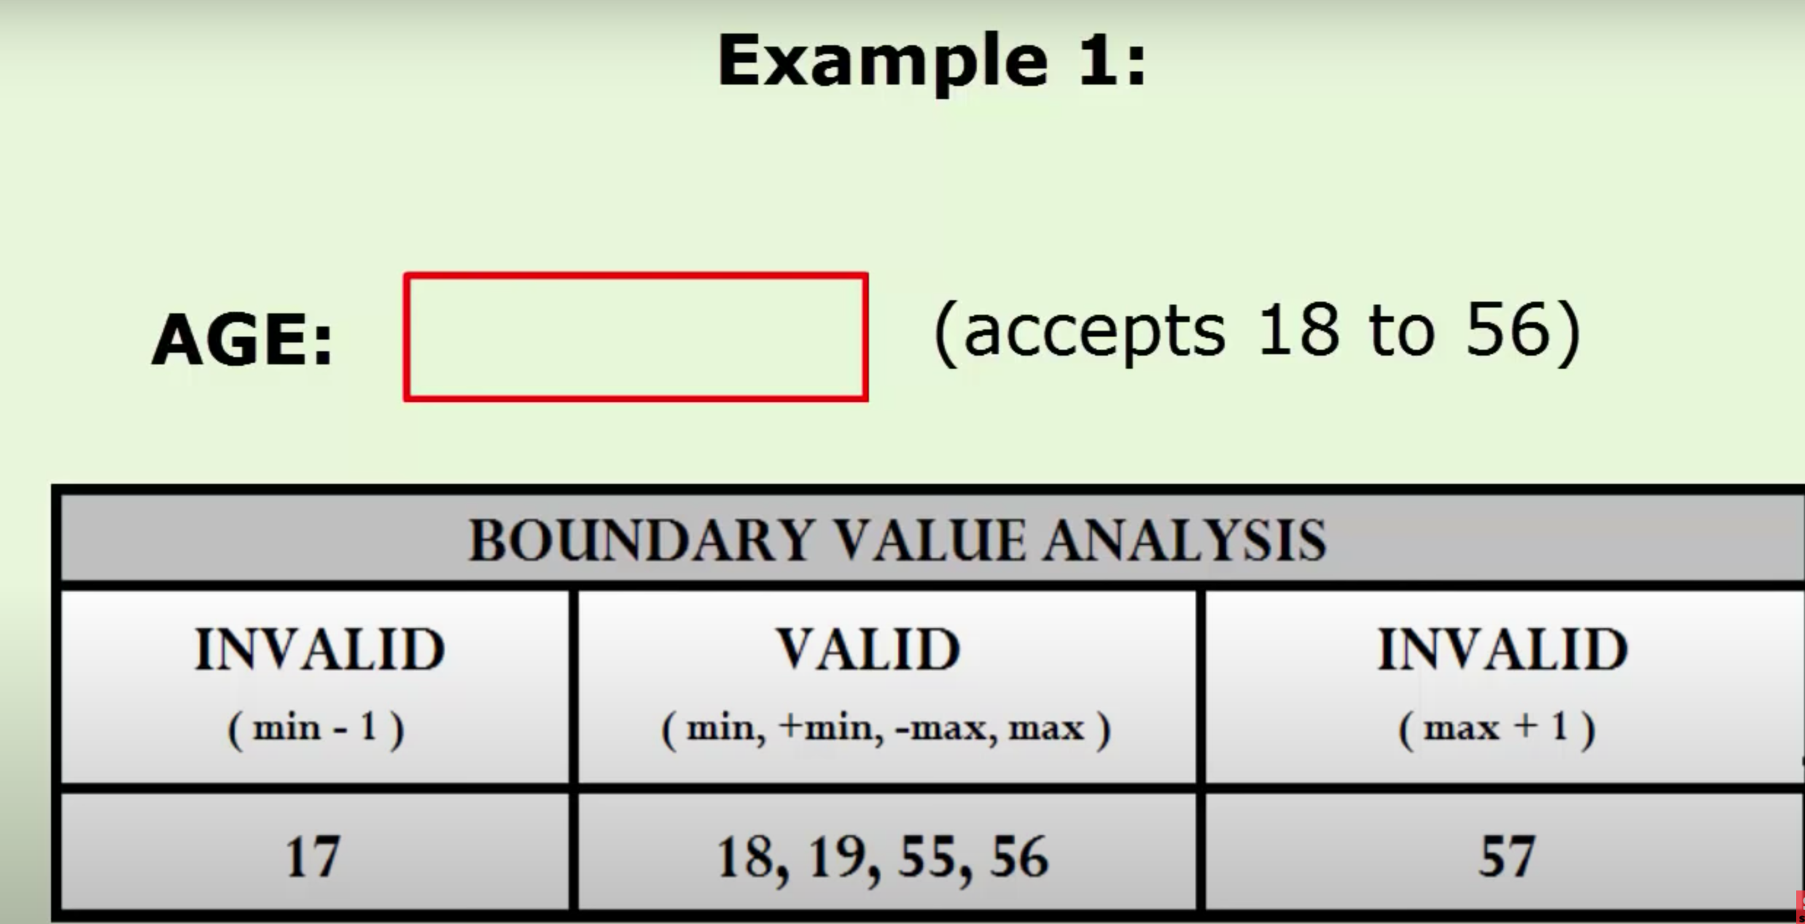
Boundary Value Analysis

Slide 23
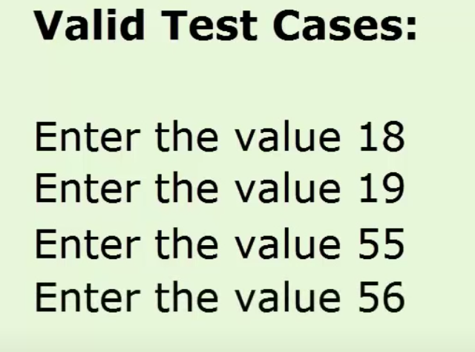
Valid Test Cases

Slide 24
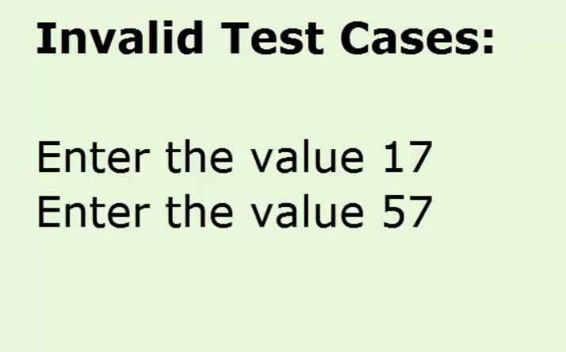
Invalid Test case

Slide 25
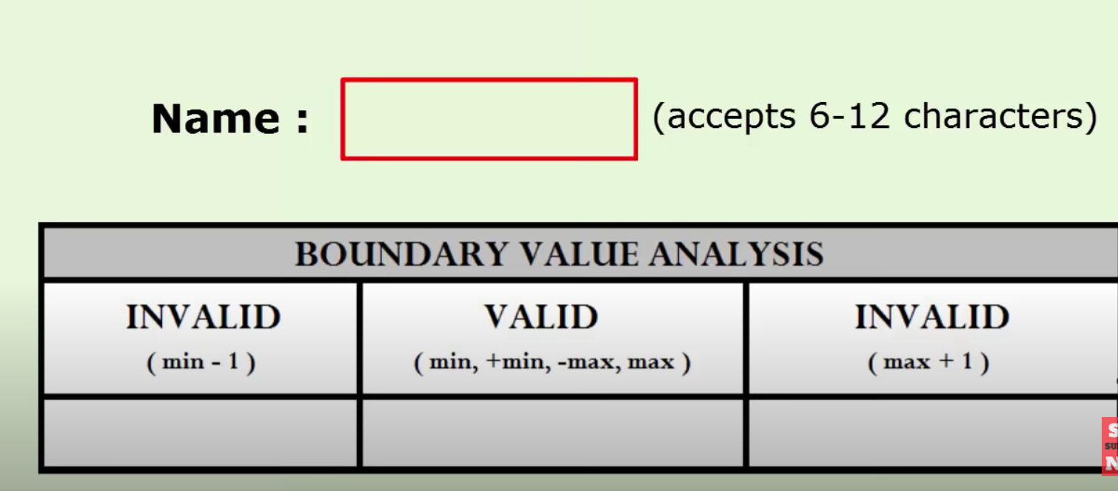
Boundary Value Analysis

Slide 26
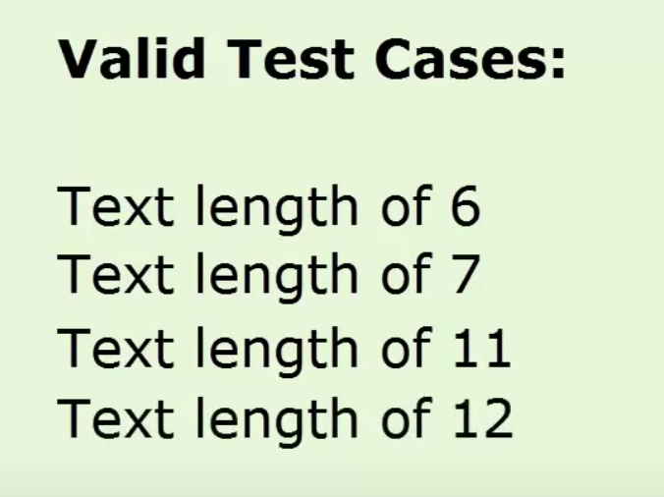
Valid Test Cases

Slide 27
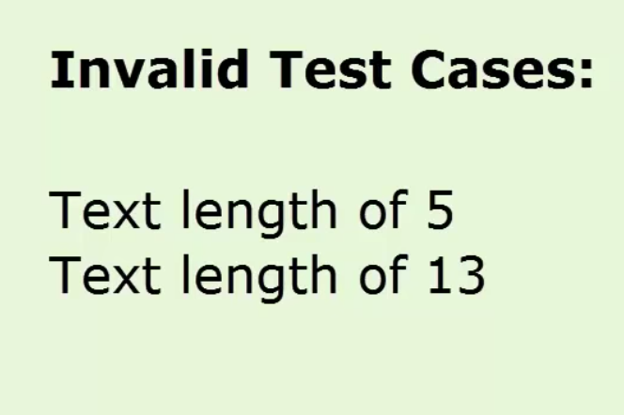
Invalid Test Case

Slide 28
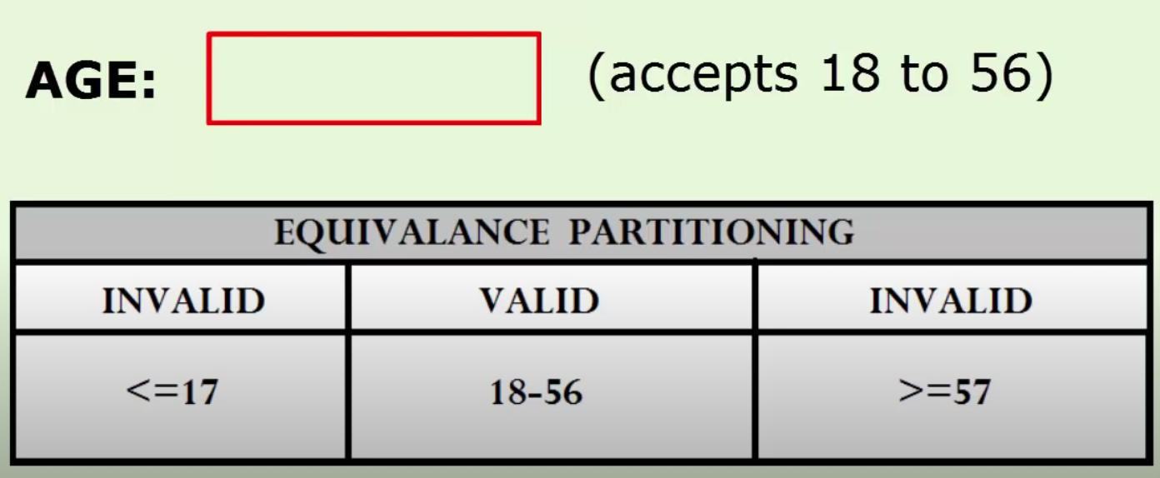
Equivalent Partitioning

